Slide 1
Social Media Report
Notes:
Month at a glance
Web Stats – convert to 1 page
Social Results – convert to 1 page
Add page for TashRizzo: Omnichannel
Add Page for SUAS Linkedin Discussion

Slide 2


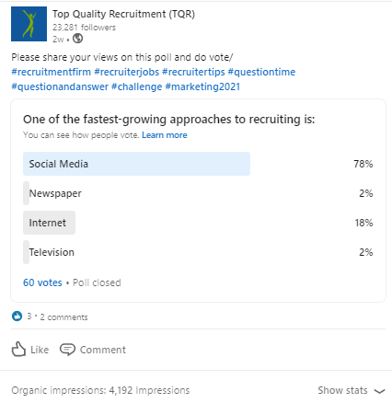
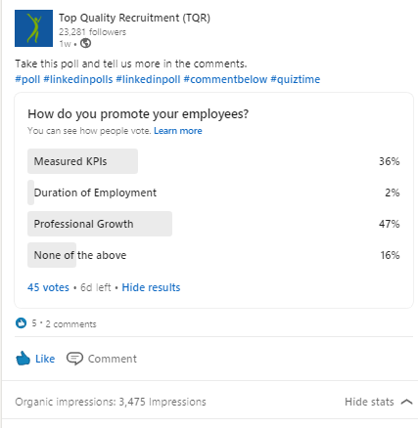
Top Posts for July 2021 LinkedIn
4,192
Impressions
63
Clicks
3
Reactions
1.65%
Engagement
3,475
Impressions
73
Clicks
5
Reactions
2.47%
Engagement
190
Impressions
2
Clicks
0
Comment
16.2%
Engagement

Slide 3




Top Posts for July 2021 Facebook
1.5K
People Reached
34
Clicks
69
Reaction
1.4K
People Reached
4
Clicks
28
Reaction
1.1K
People Reached
2
Clicks
57
Reaction

Slide 4
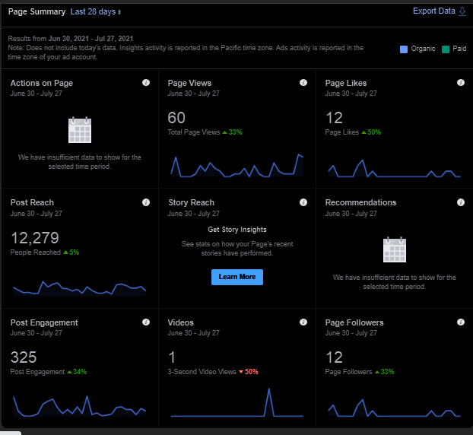
Top Posts for July 2021 Facebook

Slide 5

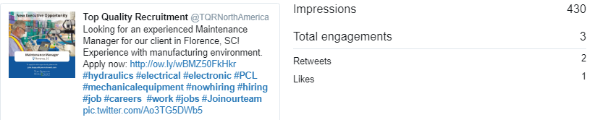
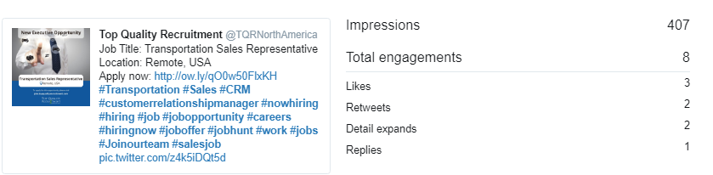
Top Posts for July 2021 Twitter

Slide 6
